Slide 1



Unit - 3
Machine Learning

Slide 2
Chapters for Discussion
Chapter - 1
Introduction – Machine Learning – Supervised, Unsupervised ML
Chapter - 2
Linear Machine learning model
Chapter - 3
Non-Linear Model

Slide 3

Chapter
Introduction – Machine Learning – Supervised, Unsupervised ML
1

Slide 4


DISCLAIMER
The content is curated from online/offline resources and used for educational purpose only.

Slide 5

Learning Objectives
Differentiate between classification and regression techniques and identify how each can be applied to sustainability-focused projects.
Describe real-world examples of supervised learning applications in sustainability, such as predicting energy consumption, classifying waste types, and monitoring biodiversity.
Understand the significance of error metrics (e.g., RMSE, MAE) in regression analysis and interpret their relevance for environmental forecasting.
Develop and apply regression models to predict sustainability-related outcomes, such as energy consumption, greenhouse gas emissions, or crop yields.
Evaluate the performance of supervised learning models using appropriate metrics (e.g., accuracy, precision, recall) and interpret the results in the context of environmental or sustainability goals.
Build classification models to categorize sustainability-related data, such as classifying areas of biodiversity risk, types of waste, or pollution levels.
GOAL
Notes:
Lets, discuss about Learning objectives,
Differentiate between classification and regression techniques and identify how each can be applied to sustainability-focused projects.
Describe real-world examples of supervised learning applications in sustainability, such as predicting energy consumption, classifying waste types, and monitoring biodiversity.
Understand the significance of error metrics (e.g., RMSE, MAE) in regression analysis and interpret their relevance for environmental forecasting.
Develop and apply regression models to predict sustainability-related outcomes, such as energy consumption, greenhouse gas emissions, or crop yields.
Evaluate the performance of supervised learning models using appropriate metrics (e.g., accuracy, precision, recall) and interpret the results in the context of environmental or sustainability goals.
Build classification models to categorize sustainability-related data, such as classifying areas of biodiversity risk, types of waste, or pollution levels.

Slide 6
What is Supervised Learning?
Supervised learning is a type of machine learning in which a model is trained on labelled data, where the input data is paired with the correct output labels.
Supervised learning algorithms learn by analysing a large dataset of labelled examples and adjusting the parameters of the model in order to minimize the error between the model’s predictions and the correct output labels.
Once the model has been trained, it can be used to make predictions on new, unseen data.
Notes:
What is Supervised Learning?
One way to think about supervised learning is to compare it to a student learning from a teacher. In this analogy, the teacher is the labelled data, and the student is the machine learning model. The teacher provides the student with examples of the correct answer (the output label) along with the corresponding input data (e.g. a math problem and the correct solution). The student uses this information to learn how to solve similar problems on their own.
Once the student has learned from the teacher, they can use their knowledge to solve new problems (make predictions on new, unseen data). The teacher can also evaluate the student’s performance by testing them on problems they haven’t seen before (testing the model on a separate dataset). If the student’s performance is satisfactory, they can be considered ready to solve similar problems on their own.
Supervised learning is a type of machine learning in which a model is trained on labelled data in order to learn how to make predictions based on the patterns and relationships in the data

Slide 7
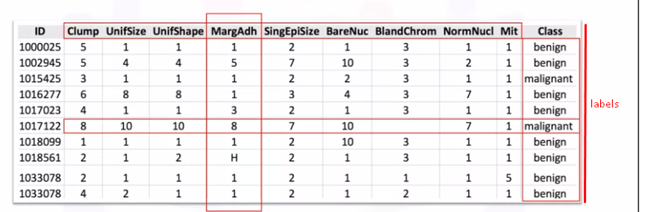
Labeled data
Labelled data,
Used in supervised machine learning
Needs human to label
Expensive, hard and time-consuming to get and store
Used for complex predicting tasks
Notes:
Labeled data
As the name suggests, labeled data (aka annotated data) is when you put meaningful labels, add tags, or assign classes to the raw data that you've collected. What is a label in machine learning? Let’s say you are building an image recognition system and have already collected several thousand photographs. Labels would be telling the AI that the photos contain a ‘person’, a ‘tree’, a ‘car’, and so on.
The machine learning features and labels are assigned by human experts, and the level of needed expertise may vary. In the example above, you don't need highly specialized personnel to label the photos. However, if you have, say, a set of x-rays and need to train the AI to look for tumours, it's likely you will need clinicians to work as data annotators. Naturally, due to the human resources necessary, hand-labelling data is much more expensive than gathering raw unlabelled data.

Slide 8
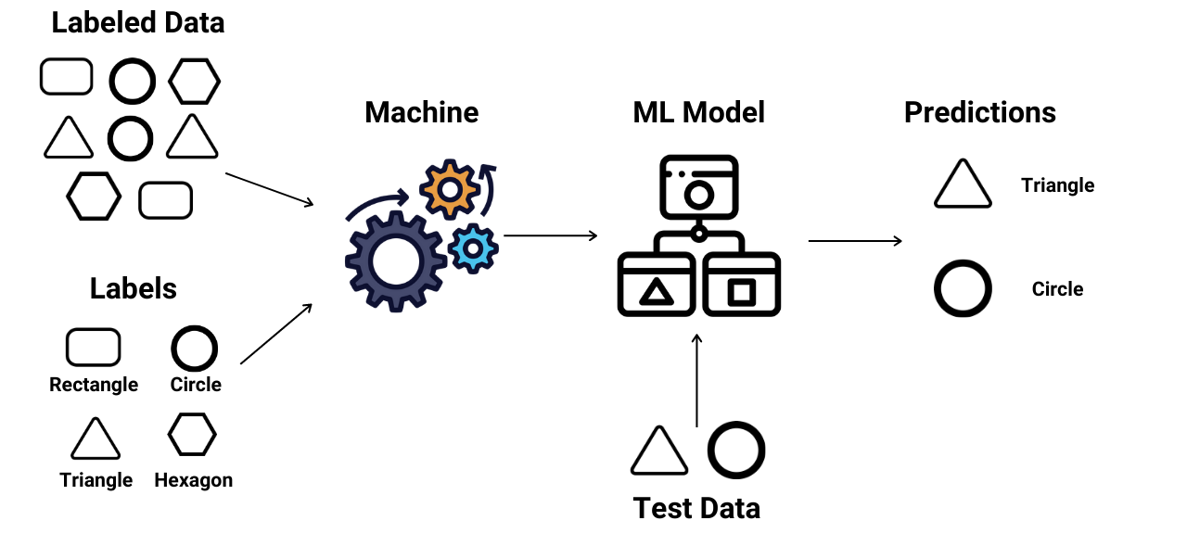
How Supervised Machine Learning Works?
Notes:
How Supervised Machine Learning Works?
Based on the supervised machine learning work flow,
Training Phase: During the training phase, the algorithm is presented with the labelled data. It learns from this data by identifying patterns and relationships between the inputs and outputs.
Model Building: Based on the labelled data, the algorithm builds a model that can generalize from the training examples to make predictions on new, unseen data.
Prediction Phase: Once the model is trained, it can be used to make predictions on new data. The model takes an input, processes it through its learned knowledge, and produces an output prediction.
Supervised learning builds a model that maps inputs to outputs based on labeled training data. The process involves data preparation, model selection, training, evaluation, and tuning. Once complete, the model can predict outcomes for new data with high accuracy, making supervised learning essential for many applications in data science and AI.

Slide 9
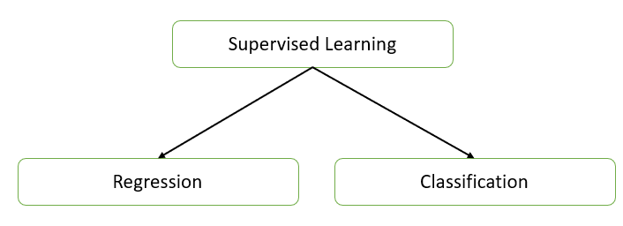
Types of Supervised Learning
There are two primary types of supervised learning,
Regression: Regression tasks involve predicting a continuous numerical value from input data. The output variable in regression is continuous.
Classification: Classification tasks involve predicting a discrete label or category from input data. The output variable in classification is categorical.
Notes:
Types of Supervised Learning
Regression: Regression tasks involve predicting a continuous numerical value from input data. The output variable in regression is continuous.
Classification: Classification tasks involve predicting a discrete label or category from input data. The output variable in classification is categorical.
Supervised learning is a type of machine learning where a model is trained on labeled data, meaning the input data is paired with corresponding output labels. The goal of supervised learning is to learn a mapping from inputs to outputs so that the model can make predictions on unseen data.
Supervised learning encompasses both regression and classification, each serving different purposes based on the nature of the output variable. Understanding the types of supervised learning helps in selecting appropriate algorithms and techniques for specific problems in machine learning.

Slide 10
Supervised learning problems
Weather Prediction: Estimating future weather conditions (temperature, humidity, precipitation) based on historical weather data and other environmental factors.
Energy Consumption Forecasting: Predicting energy usage in buildings or cities based on factors like time of year, weather conditions, and historical consumption patterns.
Medical Cost Prediction: Estimating healthcare costs for patients based on their medical history, demographic data, and treatment plans.
Notes:
Supervised learning problems
Supervised learning problems are scenarios where a model is trained on labeled data, allowing it to make predictions or classifications based on input features. Here are some common supervised learning problems across various domains, categorized by classification and regression.

Slide 11
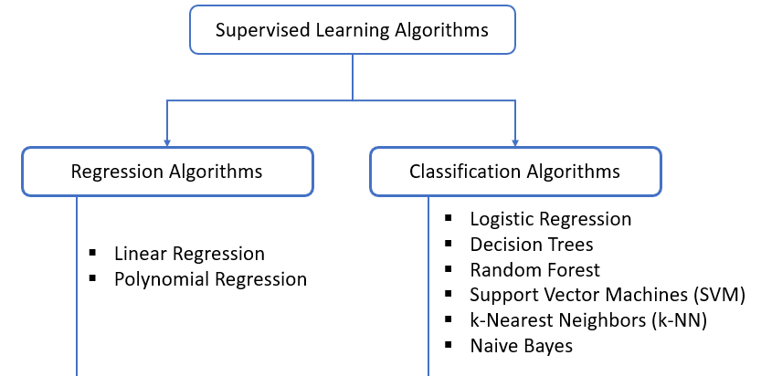
Supervised Machine Learning Algorithms
Notes:
Supervised machine learning algorithms are designed to learn from labeled data, where the model is trained on input-output pairs to make predictions on unseen data. These algorithms can be broadly classified into two categories: classification and regression.

Slide 12
Supervised Machine Learning Algorithms Implementation steps
Define the Problem
Data Collection and Understanding
Data Preprocessing
Data Splitting
Algorithm Selection
Model Training
Model Evaluation
Model Optimization
Final Model Evaluation on Test Data
Model Deployment
Notes:
Define the Problem
The objective is to identify the problem type (e.g., classification or regression) and define the output variable (target variable).
Decide if data is ready or if it needs to be collected.
Performance Metric is choose the evaluation metrics like accuracy, precision, recall, F1-score (classification), or mean absolute error (MAE), mean squared error (MSE), R-squared (regression).
Data Collection and Understanding
Data Sources is gather the dataset from sources like CSV files, databases, or online repositories.
Exploratory Data Analysis (EDA) need to conduct an initial analysis to understand data distributions, correlations, missing values, and outliers.
Data Preprocessing
Data Cleaning technique is addressing missing values (impute or drop), remove duplicates, handle outliers, and standardize/normalize data.
Feature Encoding is converting categorical variables into numerical formats using methods like one-hot encoding or label encoding.
Feature Scaling is applying scaling techniques like StandardScaler or MinMaxScaler, especially if using algorithms sensitive to data scales (e.g., SVM, KNN).
Feature Engineering is creating new relevant features, transform variables, or combine existing features to add predictive power.
Data Splitting
Split data into training, validation, and test sets. Typical ratios are:
Training: 60-80%
Validation: 10-20%
Testing: 10-20%
Cross-Validation (optional), Use K-fold cross-validation to enhance model evaluation by using multiple subsets of data for training and validation.
Algorithm Selection
Choose an appropriate supervised algorithm based on:
Problem Type: For classification, algorithms include Logistic Regression, SVM, Decision Tree, Random Forest, KNN. For regression, options are Linear Regression, SVR, Decision Tree Regressor, etc.
Data Size and Dimensionality: Certain algorithms (like Random Forest) handle large datasets and high-dimensional data well, while others (like KNN) may struggle.
Model Interpretability vs. Accuracy: For interpretability, simpler models like Linear Regression are better. For higher accuracy, complex models like Neural Networks or Random Forests may be ideal.
Model Training
Initialize the algorithm with default or chosen hyperparameters.
Fit the Model: Use model.fit(X_train, y_train) to train the model on the training data.
Hyperparameter Tuning: Adjust model parameters to improve performance using techniques like:
Grid Search: Searches over specified parameter values exhaustively.
Random Search: Samples random combinations of parameters.
Bayesian Optimization or Automated Machine Learning (AutoML) tools for complex tuning.
Model Evaluation
Training and Validation Scores: Evaluate the model on training and validation data to understand if it is overfitting or underfitting.
Metric Calculation:
Classification: Calculate metrics like accuracy, precision, recall, F1-score, and area under the ROC curve (AUC-ROC).
Regression: Compute metrics such as MAE, MSE, and R-squared score.
Cross-Validation Scores: For more reliable performance assessment, use K-fold cross-validation and check mean and standard deviation of performance metrics.
Model Optimization
Address Underfitting increase model complexity, add more features, or decrease regularization.
Address Overfitting reduce model complexity, use regularization techniques (e.g., Lasso, Ridge), increase training data, or apply dropout (for neural networks).
Feature Selection use feature importance scores to eliminate irrelevant features and improve model generalizability.
Ensemble Techniques for higher accuracy, consider ensemble methods like Bagging (e.g., Random Forest) or Boosting (e.g., XGBoost, AdaBoost).
Final Model Evaluation on Test Data
Evaluate Mode use the test set to get a final, unbiased estimate of model performance.
Error Analysis examine incorrect predictions to identify areas where the model might be improved.
Model Deployment
Save Model use libraries like joblib or pickle in Python to save the model.
Deploy serve the model using frameworks like Flask, FastAPI, or deploy on cloud platforms like AWS SageMaker, Azure ML, or GCP AI.
Monitoring the model’s performance post-deployment and periodically retrain or fine-tune the model as new data arrives.

Slide 13
What is Unsupervised Learning
Unsupervised learning is a type of machine learning where algorithms analyze and model data without any predefined labels or outputs.
Unlike supervised learning, which uses labeled data to train models, unsupervised learning deals with unlabeled data, exploring patterns, structures, and relationships within the data on its own.
Unsupervised learning techniques include clustering, dimensionality reduction, and anomaly detection.
Notes:
The potential of unsupervised learning in sustainability is vast, as it can continuously learn from large, complex, and unstructured environmental datasets. However, challenges remain, including data quality and interpretability. Green technology applications require robust data preprocessing to handle inconsistencies in ecological and sensor data. Additionally, interpreting unsupervised learning results can be complex, as the lack of labelled data complicates understanding the meaning of identified patterns.

Slide 14
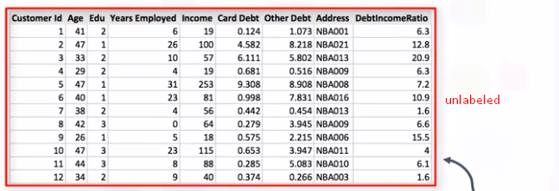
Unlabeled data
Unlabelled data is crucial in advancing the sustainability of green technology, as it provides vast, untapped resources for identifying environmental patterns, improving resource management, and driving innovative eco-friendly solutions.
Notes:
In the context of sustainability, unlabeled data holds significant potential. While labeled data is typically costly and labor-intensive to obtain, unlabeled data can be collected at scale and continuously in real-time. This data comes from numerous sources like satellite imagery, climate sensors, smart meters, and drones, offering up-to-date insights into environmental factors. By leveraging this raw data, machine learning models can identify patterns related to renewable energy, pollution levels, wildlife habitats, and more.
Despite its potential, using unlabeled data presents challenges, especially in sustainability applications. The complexity and volume of environmental data require advanced preprocessing to ensure meaningful results. Additionally, interpreting the patterns detected by unsupervised learning models can be difficult without domain expertise. Addressing these challenges demands interdisciplinary collaboration between data scientists and environmental experts.

Slide 15
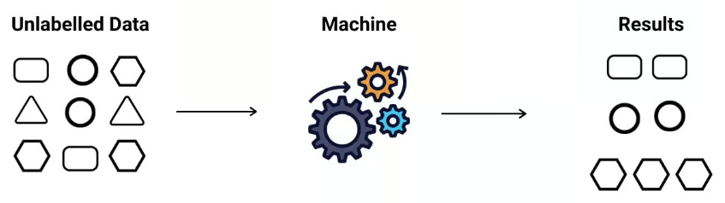
How Unsupervised learning works?
Data Collection and Preparation
Selecting an Unsupervised Learning Algorithm
Pattern Identification
Evaluation and Interpretation
Notes:
Data Collection and Preparation:
Data Collection: The process begins with gathering a large set of unlabeled data. This could include images, sensor readings, text, or other data types that have no associated labels or classifications.
Data Preprocessing: Raw data often requires cleaning and preparation to be useful. Preprocessing can include scaling, normalizing, or transforming the data into a suitable format. For instance, if the data includes numerical values, they may need to be scaled to fall within a specific range for better model performance.
Selecting an Unsupervised Learning Algorithm:
Depending on the objective, different algorithms can be used. The two main types of unsupervised learning tasks are clustering and dimensionality reduction.
Clustering algorithms, like K-Means or Hierarchical Clustering, group similar data points together based on defined similarity measures. This is helpful in applications like customer segmentation.
Dimensionality Reduction techniques, such as Principal Component Analysis (PCA) or t-SNE (t-Distributed Stochastic Neighbor Embedding), simplify data with many variables, which helps in visualizing high-dimensional data and reducing computation time.
Pattern Identification:
The model processes the unlabeled data to find hidden patterns, structures, or groupings. For clustering, this could mean identifying natural groupings among data points based on their attributes. In dimensionality reduction, the model tries to find the most important features in the data, reducing the total number of variables without losing key information.
For instance, in clustering, data points are assigned to clusters based on the distance between them. In K-Means, each data point is assigned to the nearest centroid, which represents the center of a cluster, and the centroids adjust iteratively until they reach an optimal position.
Evaluation and Interpretation:
Since there are no predefined labels, evaluating the quality of an unsupervised model can be challenging. Evaluation techniques like Silhouette Score for clustering (measuring how well-separated the clusters are) or Variance Explained for dimensionality reduction (indicating how much information the reduced data retains) are commonly used.
Interpretation of results is another challenge since patterns are found without any human-defined categories. Experts in the domain are often required to analyze the clusters or components and assign meaning to them.

Slide 16
Types of Unsupervised Learning and Algorithms
Clustering
Clustering is a fundamental technique in unsupervised learning where the algorithm groups data points into clusters based on their similarity. Each cluster ideally represents a group of items with common characteristics, making it particularly useful in areas of green technology where there is a need to categorize vast data efficiently.
Dimensionality Reduction
Dimensionality reduction simplifies high-dimensional datasets by reducing the number of variables while preserving important information. This technique is essential for green technology applications, where datasets can be large and complex—like satellite images, climate datasets, or energy grids.
Notes:
By identifying patterns and structures within raw data, unsupervised learning enables a variety of applications—from environmental monitoring to efficient resource management. In sustainability, two primary types of unsupervised learning, clustering and dimensionality reduction, provide valuable insights by grouping similar data points and simplifying complex datasets, respectively.

Slide 17
Unsupervised Learning Algorithms
K-Means
Hierarchical Clustering
Principal Component Analysis (PCA)
t-SNE (t-Distributed Stochastic Neighbor Embedding)
Notes:
K-Means: Groups data into a predefined number of clusters by minimizing the distance between data points and the centroid of each cluster.
Hierarchical Clustering: Builds a tree of clusters, useful for data with natural group hierarchies like ecosystems or soil types.
Principal Component Analysis (PCA) reduce this complexity, allowing researchers to focus on key factors influencing climate change without losing crucial information.
Sustainable farming generates vast datasets, from soil health metrics to crop yields. Dimensionality reduction, particularly through t-SNE (t-Distributed Stochastic Neighbor Embedding), helps farmers and agronomists visualize complex relationships, like the impact of soil properties on crop performance.

Slide 18


Let’s Start

Slide 19


Quiz
Which of the following algorithms is used for classification in supervised learning?
K-Means
Decision Tree
Principal Component Analysis (PCA)
Apriori Algorithm
Answer: b
Decision Tree

Slide 20
Quiz
2. Which supervised learning algorithm is primarily used for continuous data prediction?
Logistic Regression
Linear Regression
K-Means Clustering
Naive Bayes
Answer: b
Linear Regression

Slide 21
Thank You
Notes:
Thank You !!

